Slide 1
ImmerZone
Experience the non-Existent through Mixed Reality Paradigm

Slide 2
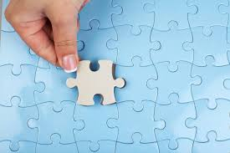
Context
Background
Trends
Business Areas

Slide 3
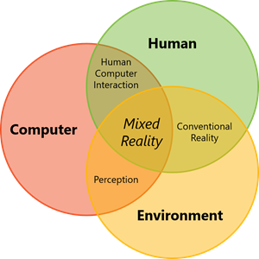
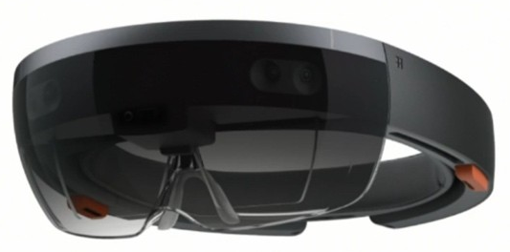
Background
1 of 2
About Mixed Reality
Mixed reality is the result of blending the physical world with the digital world, a new evolution in human, computer and environment interaction unlocking possibilities that were restricted to our imagination only so far.
An application of Mixed Reality goes beyond displays and includes spatial sound, environmental input, location etc. Combination of computer processing, human input and environmental input set the opportunity of creating a true Mixed Reality Experience.
Works using the medium of Holograms, objects made of light and sound that appear in the world around, just as if they were real objects. Holograms respond to user’s gaze, gestures and voice commands and can interact with real-world surfaces around the user. With holograms, one can create digital objects that are part of real world.
About the Device
Microsoft HoloLens enabled user to visualize and work with digital contents and objects as part of real world through Holograms bringing mixed reality promises to live.

Slide 4
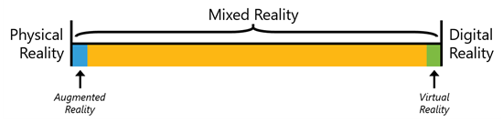

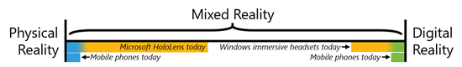
Background
2 of 2
How MR is different from AR and VR
Augmented Reality (AR) is an overlay of Digital Content on the Real World, Virtual Reality (VR) is a completely Digital Environment that fully replaces the Real World and Mixed Reality (MR) is when Virtual Environment is not just overlaid on Real World but it is anchored to interacts with that. AR and VR remains at two ends of MR Spectrum while being more towards the middle of the spectrum ensures better MR experience.
Why to use Holograms for MR Implementation
Holograms places Digital Content in Real World as if it were really there, while just Immersion just creates the Sense of Presence by hiding the Physical World and replacing that with Digital Experience. Hence Hologram based MR implementation generate better experience in terms of experiencing the Virtual amidst Real. That is why HoloLens is the leading Device for Mixed Reality Implementation.

Slide 5
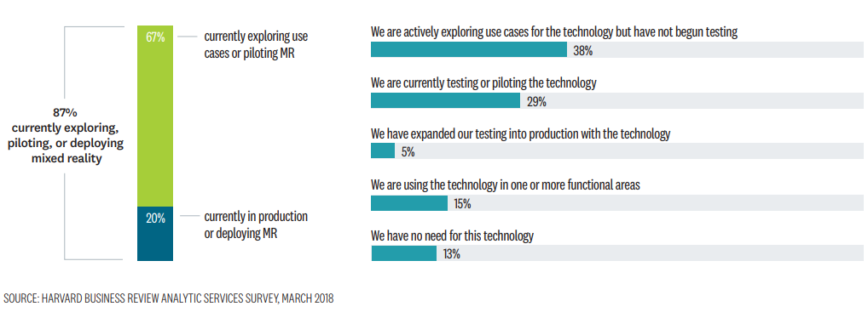
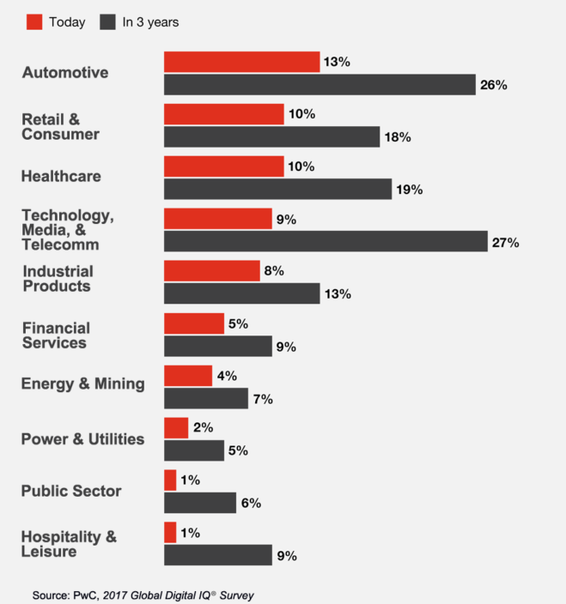
Trends
Industry wise Technology Spend Fraction in MR
Level of Business Interest in MR across Industry

Slide 6
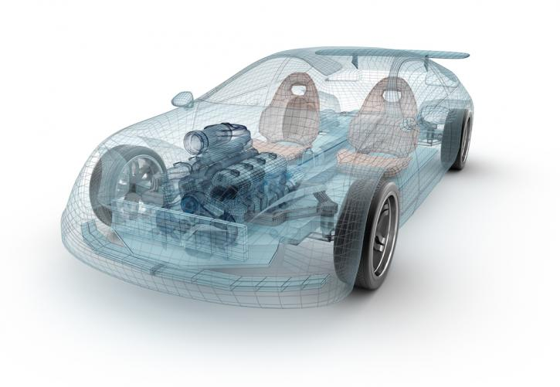
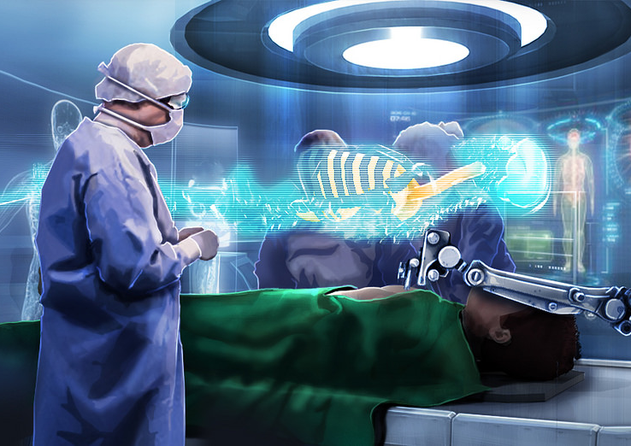
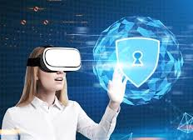
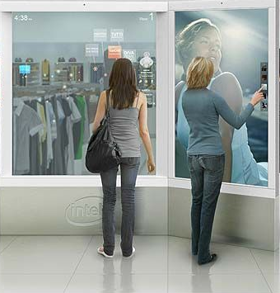
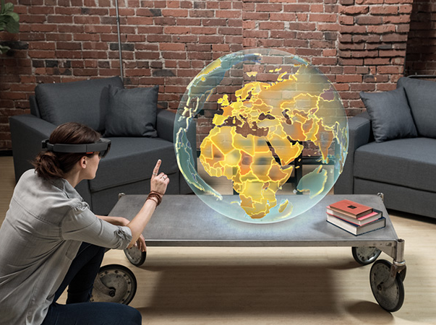
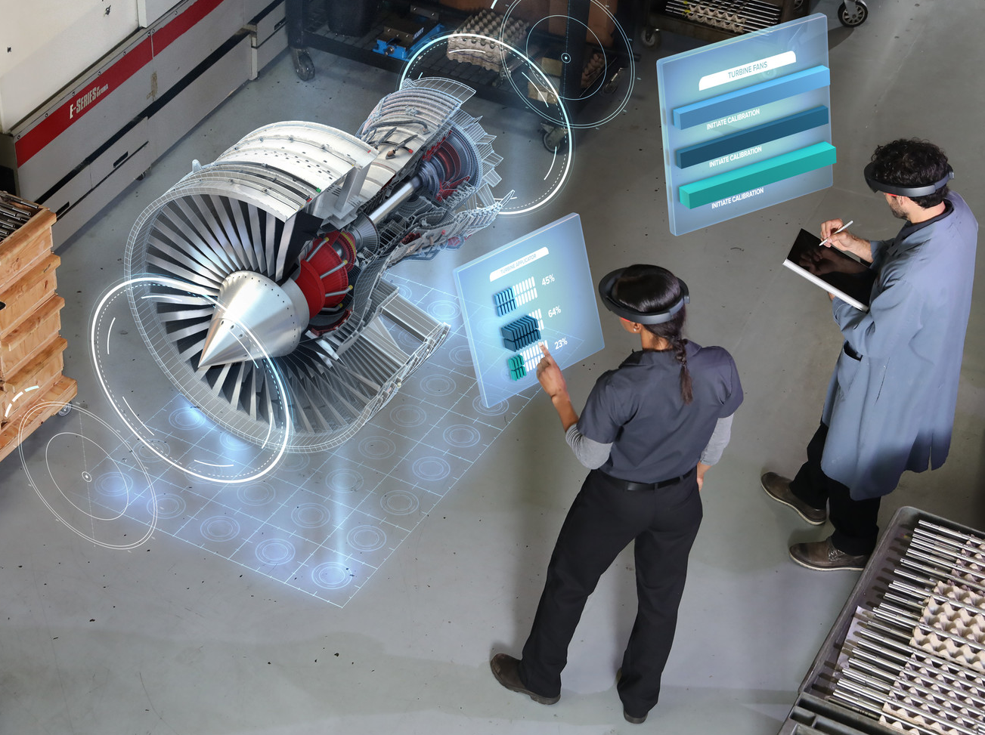
Business Areas
Industry – Automobile
Industry – Life Sciences
Industry – Financial Sector
Modelling of a Car in Design Lab
Training of Qualified Mechanics
Troubleshooting of Car Problems in Workshop
Pharma R&D in Lab
Organ and Instrument Study
Surgery Modernization
Remote Physician Visit
Security Compliant Branch Design
Loan & Mortgage Processing
Market Analysis& Trading
Industry – Retail
Industry – Education & Gaming
Industry – Manufacturing
Fitment of Fashion Items on Individual
Fitment of Household Items at Home Interior
Post Purchase Guided User Manual
Education & Game Design
Geographical, Medical, Aeronautical Study
Action based Gaming in Physical Ecosystem
Product Design
Training of Qualified Mechanics
Troubleshooting of Product Issues
Remote Resolution by Mechanics

Slide 7
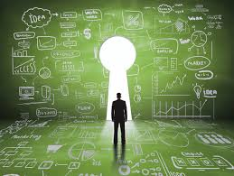
Solutions
Approach
Feature Set
Architecture
Technology

Slide 8
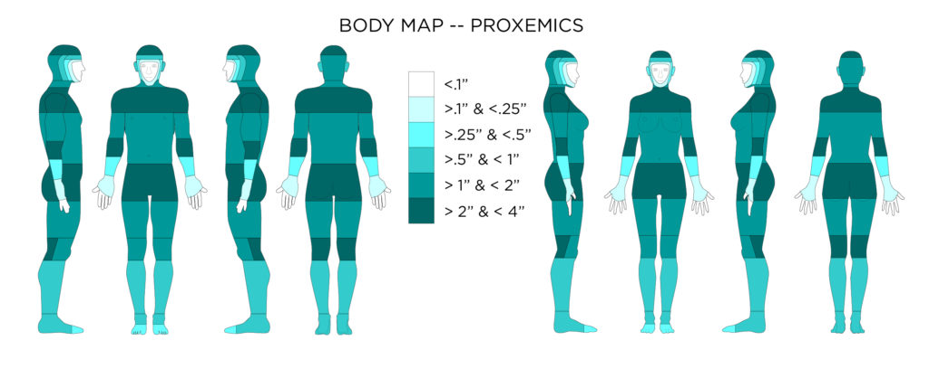
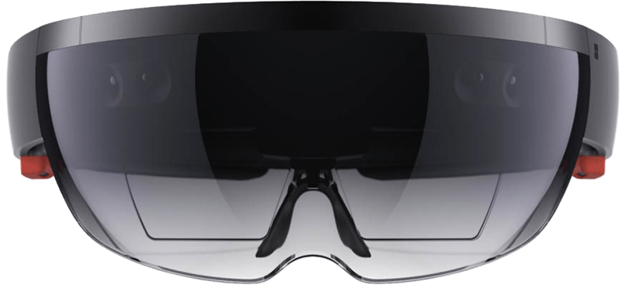
Approach
Human Body Action as Controller
Eye Movement
Neck Movement
Natural Gaze Range
360 Degree Coverage
Sitting / Standing position
Arms Reach & Movement
Free Body Movement
Working with Senses
Surrounding Ambience works as Digital Interface with Physical Parameters
Device Support
Distance Design
Vergence Accommodation
Computer Vision
Touch
Proprioception
Sound
Guiding Principles
  Head Tracking is the Primary Sensory Demand
  Frame rates needs to controlled in moderate way
  Resolution issues are less noticeable when subject matter is within tangible distance
  Movement breaks the illusion or presence unless accompanied by an obvious means of Locomotion

Slide 9






Feature Set
Handling Parts & Objects
Display Object List as Carousel
Assembly of Composite Object from Parts Palette
Disassembling of Object into parts
Iterative Disassembly of Objects
Real & Virtual Collaboration
Multi-way discussion with Individuals over IMs
Call and Texting to Phone
Virtual Presence of Remote SME
Live Sharing of MR view from Collaborating User(s)
Co-creation of Design Objects
Diverse User Action Types
Spatial Drag, Tap, Bloom
Vision Tracking driven Command
Gesture Command
Voice Command
Guided Navigation
External Data / Content Association
Access to Relational / Non-Relational Data
Artifacts from Repository e.g. Manual
Image Library Browsing e.g. Catalog
Playback Media e.g. Training Video
Diverse Object Operations
Copy & Clone
Apply Colours and Styles
Resize and Zooming – In / Out
Spinning – automated & guided
Spatial Movement
Miscellaneous Complex Operations
Templatization & On Demand Usage of Objects
Comparison of Real and Virtual Object Parameters
Maintenance of Job Checklist with Checkpoint Status

Slide 10
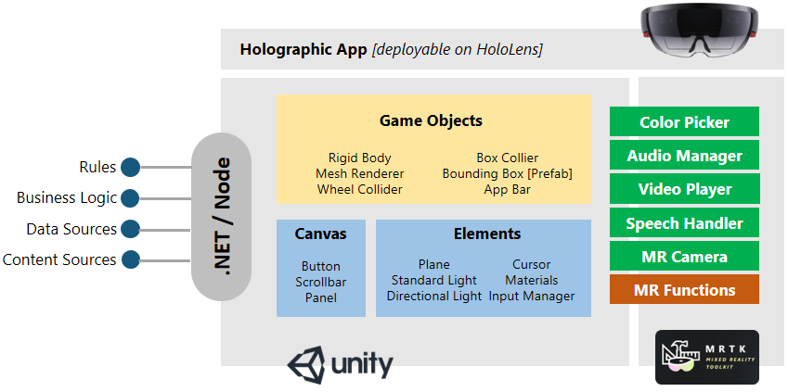
Architecture

Slide 11



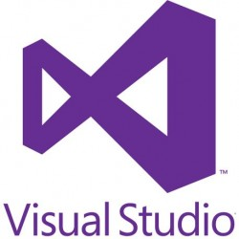
Technology

Slide 12
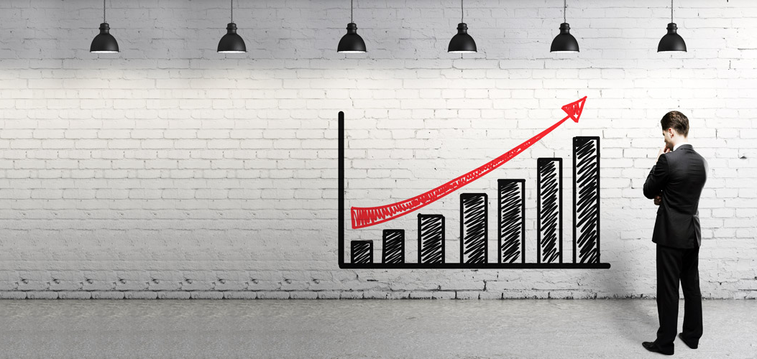
Benefits
Value Delivery
Success Stories

Slide 13
Value Delivery
Reduction in Operational Hazards of arranging heavy and complex objects physically
Reduction is Expense by accessing elements virtually yet getting the real feel of ambience
Increased Accuracy and Efficiency by watching the non-existent items
Higher User Adoption through real world feel from virtual objects
Ultra Modern Collaboration with virtual co-presence

Slide 14
Success Stories

Slide 15
Thank You

