Slide 1

KRA Tool
An eUnomia Factory Solution

Slide 2






COE as a Service Context
Best Practices
Governance
Guidance
Adoption
Intellectual Property
KRA Management
Promotion of technology and operations best practices.
Governance of service/solution implementation & consumption
Strategic Guidance, Tactical Modelling, Operation Excellence & Performance Measurement
Improving adoption of service/technology
Creation of new Frameworks and Solutions resulting into new IPs for the enterprise
Management of Teams, Tasks, Bandwidth Utilization, Planning etc. w.r.t. KRA Activities**
** HCL’s KRA tool is an end-to-end solution for addressing KRA Management needs of COEs
Demo Video available at http://hclepssupport.azurewebsites.net/Appresources/content/video/EPS.EF.KRATool.mp4

Slide 3







Typical COE Challenges
Poorly defined goals & objectives w.r.t. KRAs
Poor task/activities transparency w.r.t. team members
Lack of visibility into team bandwidth & utilization
Lack of transparency between team members & their activities/tasks
Unrealistic Task Deadlines
Poor Communication
Too much of time spent in meetings

Slide 4







Resolutions Offered by the KRA Tool
In-built tools for KRA Management w.r.t. goals, tasks & activities
Streamline Management thru utilities for managing customers, teams & timelines
Resource utilization management by offering team allocation and utilization management tools
Real-time monitoring of Team Tasks/Activities to improve capacity planning
Options to apportion effort in percentages across tasks/activities for improved project task/activities planning
Efficient & easy team/user management with options to add/edit/delete members
Able to align the KRAs of multiple teams to key Business Goals

Slide 5




Usage Perspective
Installation Pre-requisites
Reports
IIS
SQL Server
KRA Baselines Report
Task Assignation Monitoring
Effort Monitoring
Installation
Tools
Provision Database on-premises/on-cloud
Deploy to Azure App Service or On-premises Servers
Configure IIS based consumption
Master Data Management
Member Allocation
FY Planning
Task/effort Monitoring
User Management
etc.

Slide 6
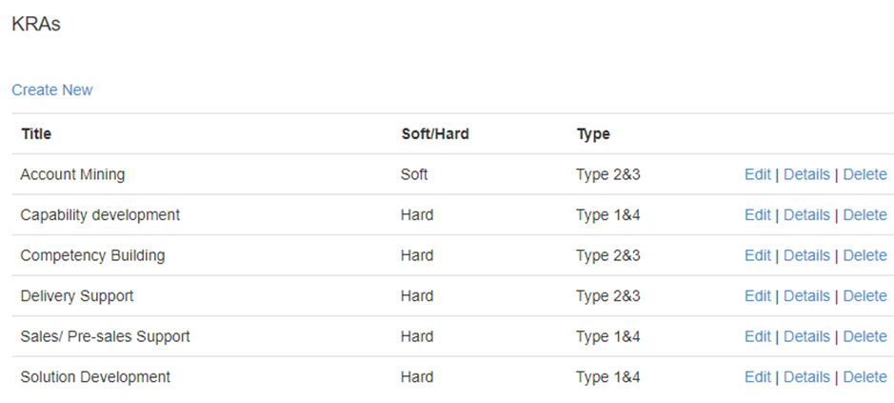
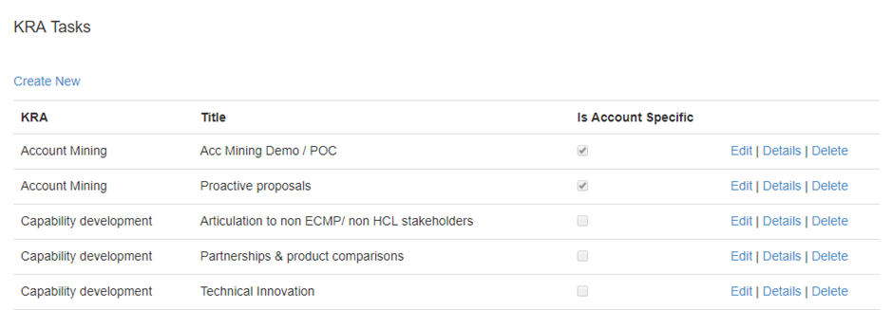

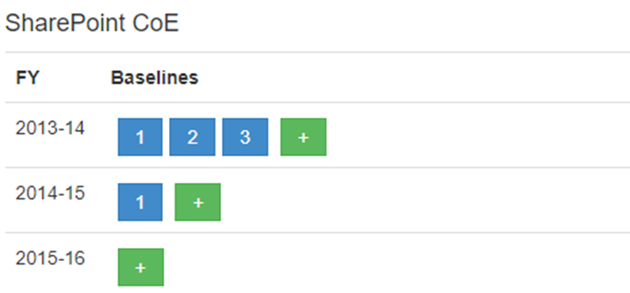
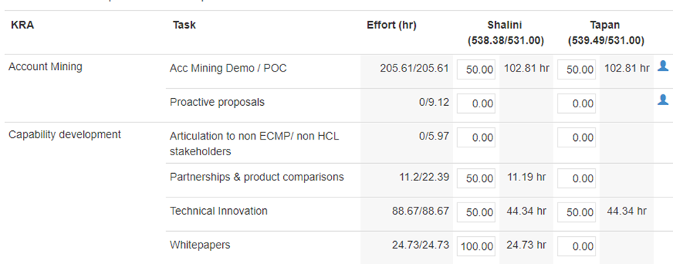
Snapshots
KRA Management
KRA Task Management
FY Planning
Assignation Management

Slide 7
Thank You

