Slide 1
Core Platform
A Deep Dive

Slide 2
Context

Slide 3
About Core Platform
Core Platform
a part of HCL EmpFinesseTM Suite
is a
Manifestation of Human-Machine Partnership through an end-to-end Intelligent Execution Pipeline for Queries and Actions

Slide 4
Why Core Platform
Faster Processes to improved User Satisfaction Index
Increased Productivity to Quicker GTM Cycle
Simplified Help Desk Functions to Enhanced Effectiveness
Reduced Human Dependency to Higher Accuracy
Reduced Expense in Complex Operations
Analyzed History Data to Upfront Troubleshooting
Correlated Event Analysis for Proactive Preventions
Anytime Anywhere Access to Higher Adoption

Slide 5
Differentiators
Infinite Scalability
  Multi-Brain Coexistence
  High Accuracy Coopetition
  Cross Functional Brains
  Scale Up till Boundary
  Scale Out beyond limit
Limitless Portability
  Combination of Any BOT, Brain, Orchestration
  High Reuse of same AI item
  Completely exposed over REST, easily consumable
Technology Independence
  Cross Tech Coexistence at all tiers
  Hybrid Layered Ecosystem
  Scoring & Rule Engine driven High Accuracy
  Best of Breed Choice of Tools
3-Step
Design
Power User Empowerment
  Reduced dependency on Technical Hand
  Business SMEs deliver faster and accurate learning
  Browser based Experience
Simplified Training
  Optimal Brain, Intent, Entity, Utterance Design
  Audit driven conversation analysis and Re-learning
  Semi & Fully Auto mode
  Identification of appropriate Platform(s) for Use Case(s)
  Brain Identification, Type Determination and Optimal Distribution of Use Case(s) across Brains
  Brain Component Design (Intent, Entity, Utterances, Phrase, Regex etc.)

Slide 6
Platform Deep Dive

Slide 7
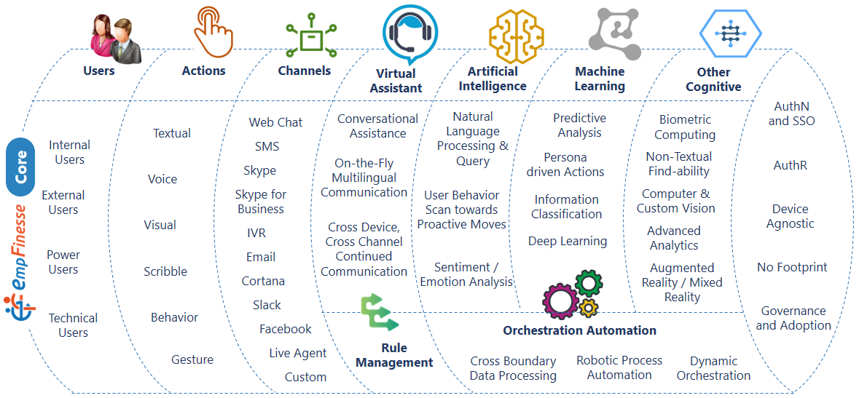
Construct

Slide 8
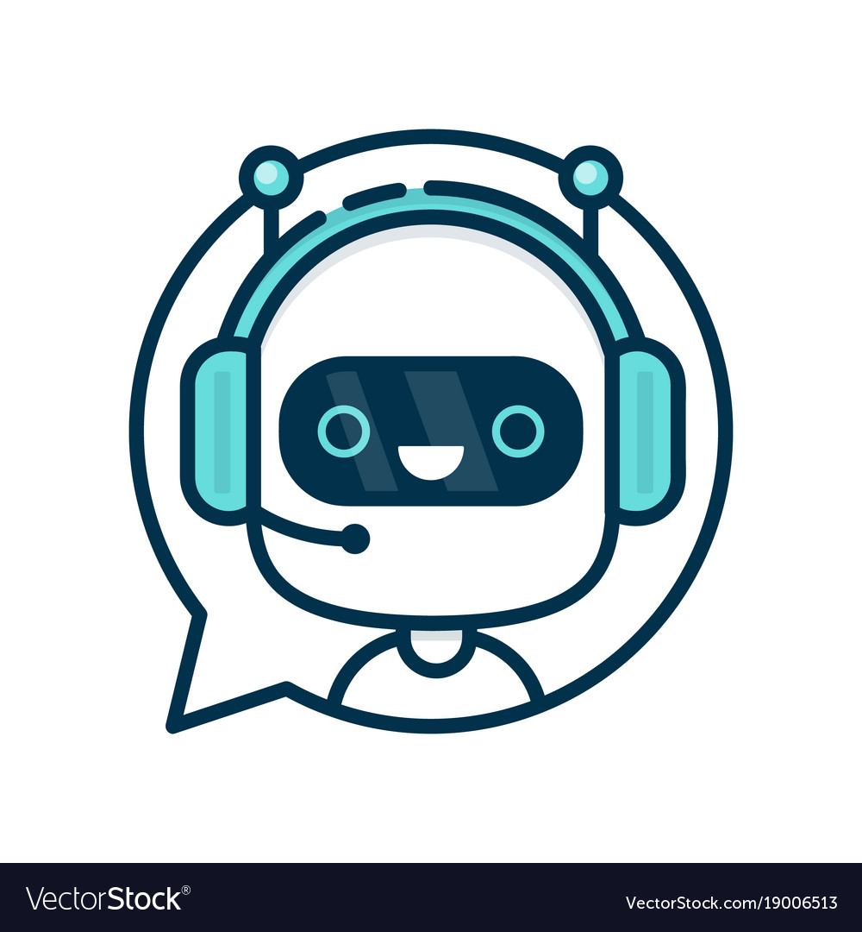
Features – BOT Management
Multi BOT Ecosystem
Coexistence of BOT from multiple Technologies
Live BOT Registration
Many to Many relationship between BOTs and Brains
Multi Channel Access
Custom Branded Web Chat
Skype for Business & Skype
Microsoft Teams
SMS & Email
Social like Facebook Messenger and Slack
Digital Assistant like Cortana, Alexa and Google Assistant
Multi Mode Communication
Textual Communication
Voice Command
Scribble Feed
Gestural Input
Behavioural Input for Proactive Action
Integrated Non-BOT Communication
Seamless Transfer to / from Live Agents
Seamless Transition to / from Interactive Voice Responses
Cultural Diversity
Automated User Language Identification
Response in User Language
On Demand Service based Translation
Predefined Resource based Translation
Power User driven BOT Management
BOT Parameters customizable by Power Users
On Demand / On Schedule Activation / Deactivation of BOTs through Registration Console
BOT to BOT Interaction
Cross Boundary BOT to BOT Communication
Configuration based Interaction with third party BOTs
Non Functional Boosters
Caching for Optimized Performance
Secured Access through various Authentication Modes – LDAP based, Multi Factor, Biometric integrated
Itemized Auditing
*** Most features are part of latest Release of Core Platform while some features are still WIP

Slide 9
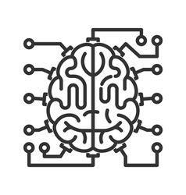
Features – Brain Management
Multi Brain Ecosystem
Coexistence of Brains from multiple Technologies
Coexistence of Cross Functional Brains
Infinite Scale Out of Brain Ecosystem
Natural Language Expertise
Strong Natural Language based Conversation
Spell Check, and Synonyms
Regular Expressions
Content Moderation
Functional Diversity
Generic Query based Brains
Personalized Query based Brains
Personalized Transaction based Brains
Proactive Brains working on Event or Data Correlation
Conversational Diversity
Direct Textual Communication
Dialog or Prompts
Hyperlink based Information
Structured Feedback Processing
Live Validation
Embedded Content
Personalization and Contextualization
Authorization on Use Cases
Persona based Filter
Contextual Hold
Channel based Filter
User Property based Filter
Trend based Filter
Power User driven Brain Management
Consistent Brain Definition across base technology platform
Live Brain Registration
UI driven Use Case Management
Multi-Level editing by Power Users
Time driven Publishing Process
End-to-End Brain
Life Cycle
Complete Brain Life Cycle from Power User Console irrespective of Technology
User does not require to remember technology wise different structures
Controlled Learning
Audit based identification of New / Unknown Utterances
Auto loading of shortlisted Utterances to Brain(s)
Automatic / Semi-Automatic Training
Accuracy Booster Tools and Techniques
*** Most features are part of latest Release of Core Platform while some features are still WIP

Slide 10

Features – Orchestration Management
Multi Recipe Ecosystem
Cross Boundary Backend System Integration across Technologies
Cross System Integration where cross-system trust is challenged
Seamless connection with Brains
Power User driven Orchestration Management
Recipe Registration
Recipe Definition Management
Publishing Ecosystem to control Orchestration availability
Multi Level Orchestration Organization
Recipe Store holding all Recipes
Cartridges as Building Blocks of each Recipe
Cartridges comprises of
  Actions
  Connections
  Sequence
Standardized Integration Approach
All Integration through API Gateway only leading to better management of Integration Definition
Supporting any REST interface to be connected
Keeping the core Integration Responsibility out of boundary
*** Most features are part of latest Release of Core Platform while some features are still WIP

Slide 11
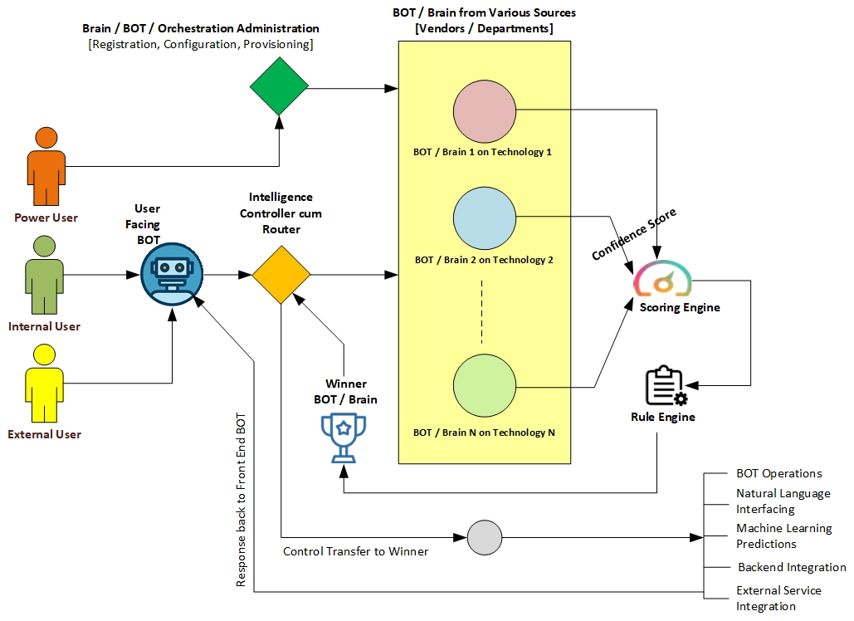
Techno-Functional Flow

Slide 12
Technical Perspectives

Slide 13
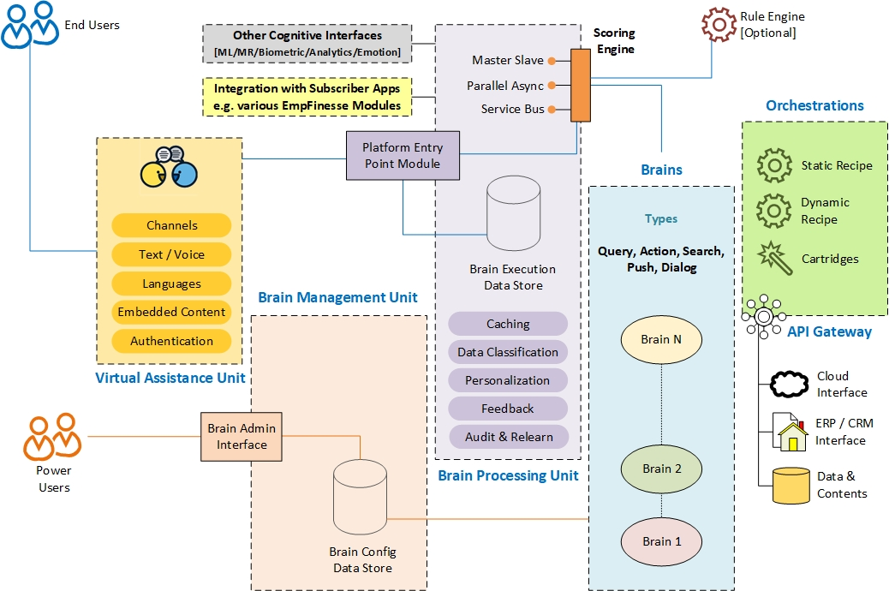
Architecture

Slide 14
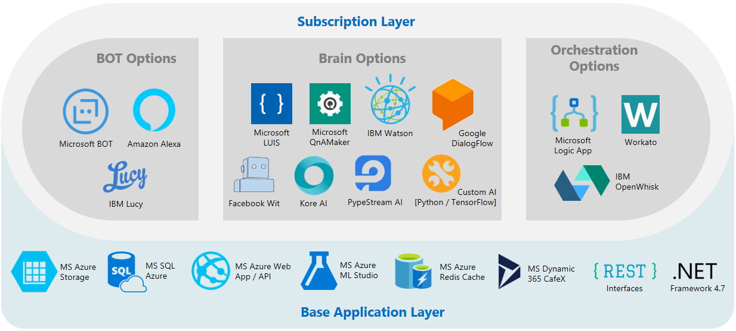
Technology Touchpoints
*** Templates for most Technologies as mentioned for Subscription Facing Layer are part of latest Release of Core Platform while onboarding of remaining technologies are WIP

Slide 15
Success Stories

Slide 16

Employee Help Desk at Global Retail & CPG Giant
P&G is working toward automating as much as 90% of claims investigations in the accounts-receivable division next year, and a bot named Lucy helps quickly answer questions from employees about technical issues and benefits, Mr. Polit says. Early tests this year show the bots are increasing productivity in their areas by as much as 30%, he says.
Source - https://www.wsj.com/amp/articles/technology-innovation-isnt-just-for-tech-companies-1512505931
Key Challenges
Solution and Values
Various Departments like HR, IT, Admin, Facilities and Finance hosted their respective BOT solutions on different technology platforms like Microsoft, IBM, PypeStream etc.
Employees had to access BOTs for different services separately with no integrated system available lowering user adoption drastically
Dependency on Technical Team even for simple changes resulted slow updates, poor training and eventually a lower accuracy level
Single Point Access to all Departments through a centralized BOT connecting all child brains in a multi brain ecosystem uniquely offered by HCL Core Platform
Supporting 20K+ employee set with 2000+ use cases across departments
Power User driven web console to register, configure and provision BOTs / Brains / Orchestrations reducing dependency on technical team in BAU cycle
Coexistence of Brains from various technologies executing intelligence from all of those in parallel
Integrated with several backend system within customer data centre, third party vendor system or on cloud services using API Gateway model
Inclusion of Personalization and Contextualization features
Simplified semi automated Training towards high accuracy
NFRs like multifactor authentication, caching, multi lingual included

Slide 17
More Workforce focused Implementations
HR Assistant Solution
for Major Australian Bank
Departmental BOT Consolidation
for Top Global Beer Manufacturer
Key Challenges and Asks
Increasing Support Calls to Internal Service Desk for Human Resource Department
Frequent requests for routine Queries / Actions consumes more time leaving low bandwidth for Complex Issues
Hardly referring to Data Trends / History Data to take Proactive actions towards prevention of any issues
Solution and Values
Introduced HR Personal Assistant with natural language skill addressing all basic L1 Queries and Actions without human intervention
Seamless transition to / from Live Agents to BOT from same Conversation Window offering a unified experience to employees
Continuous Monitoring of Transaction Data by BOTs to raise alerts on anomalies as per pre-set rules proactively
User Feedback based training
Power User driven Administration and Maintenance Console
Key Challenges and Asks
Departments having own BOTs on disparate Technologies needed consolidation through single BOT interface
Anytime loading of New BOT on New Technology
Existence of diverse type of Queries and Actions to be included under BOT actions
Need of Event driven Proactive Notification
Solution and Values
Deployed Multi Brain Ecosystem to included BOT / Brains from Microsoft, IBM, Amazon and Home Grown ones
Proactive Notification from Monitoring BOT for various Events
Implementation of multi-factor authentication, Feedback mechanism, Data Classification, Personalization etc.
Power User driven Administration and Maintenance Console

Slide 18
Few Consumer focused Implementations
Tax Consultancy to Public Audience
for European Tech Major
Billing Help Desk
for German Insurance Giant
Key Challenges and Asks
Tax Service Desk was flooded with User Calls resulting no bandwidth
Long waiting hours for Users for simple queries
Work Pressure resulted inaccuracy in responses
Huge volume of Use Cases to maintain and refer while responding
Solution and Values
47000+ Tax Queries were consolidated with answers under a natural language enabled ambience
A cognitive platform accessible from anytime anywhere over various channels and auto-detectable multilingual capability by users for Tax related queries
High Scalability through Multi Brain architecture to address initial load and addition of 10K+ new queries every year
High accuracy w.r.t. query responses resulting significant improvement in user satisfaction
Automation of query resolution energized internal operations and improved customer service quality
Key Challenges and Asks
Addressing Billing and Payment Queries with no human interaction
Executing Payment Transactions with no manual intervention
Integration with IVR System as one of the branch
Communications in both Textual and Voice mode
Solution and Values
Processing all online billing and payment in automated way
Integration with Payment Gateway from Conversation itself
Seamlessly integrated with IVR and Live Agent System
Addressing 100+ actions and numerous queries around billing and payment through same BOT using multi brain architecture
Voice enabled multilingual implementation
Analytics to improve Billing Help Desk performance

Slide 19
Additional Information

Slide 20
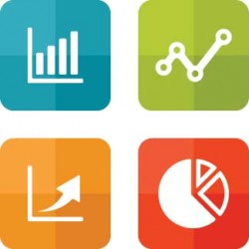
Metrics
User Satisfaction Index
Mean Productivity (for enterprise implementation)
Operational Effectiveness
Accuracy of Responses
Hours and Dollar Savings
% Reduction in Ticket Count
Adoption Footprint Count

Slide 21
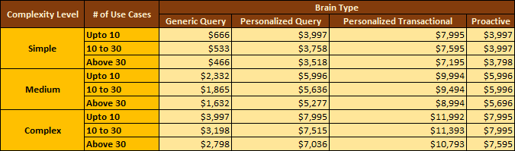
Pricing
Ballpark Unit Pricing in US$ guided by Complexity Level, Count of Use Cases, Type of Brain required, subject to revision based on information available through due diligence
Prorated Reduction in Unit Pricing along with increase in Use Case Volume
Complexity Scaling is internal to HCL Core & Fundamentals

Slide 22
Thank You

